Slide 1

TITLE :
PREDICTION OF DIABETES LEVEL

Slide 2
BATCH NO – 13
TEAM MEMBERS :
S. Gopi Krishna 2003A52015
S. Siddhartha 2003A52016
V. Sairam 2003A52020

Slide 3
PROBLEM STATEMENT:
The objective is to predict based on diagnostic measurements whether a patient has diabetes.
This dataset is originally from the National Institute of Diabetes and Digestive and Kidney Diseases.

Slide 4
INTRODUCTION :
Diabetes is a chronic, metabolic disease characterized by elevated levels of blood glucose (or blood sugar), which leads over time to serious damage to the heart, blood vessels, eyes, kidneys and nerves.
The categories are: type 1 diabetes—an autoimmune disease in which the body's own immune system attacks the pancreas, rendering it unable to produce insulin. type 2 diabetes—in which a resistance to the effects of insulin or a defect in insulin secretion may be seen; gestational diabetes; and “other types” .
Type3 Gestational ---Gestational diabetes develops in pregnant women who have never had diabetes.

Slide 5
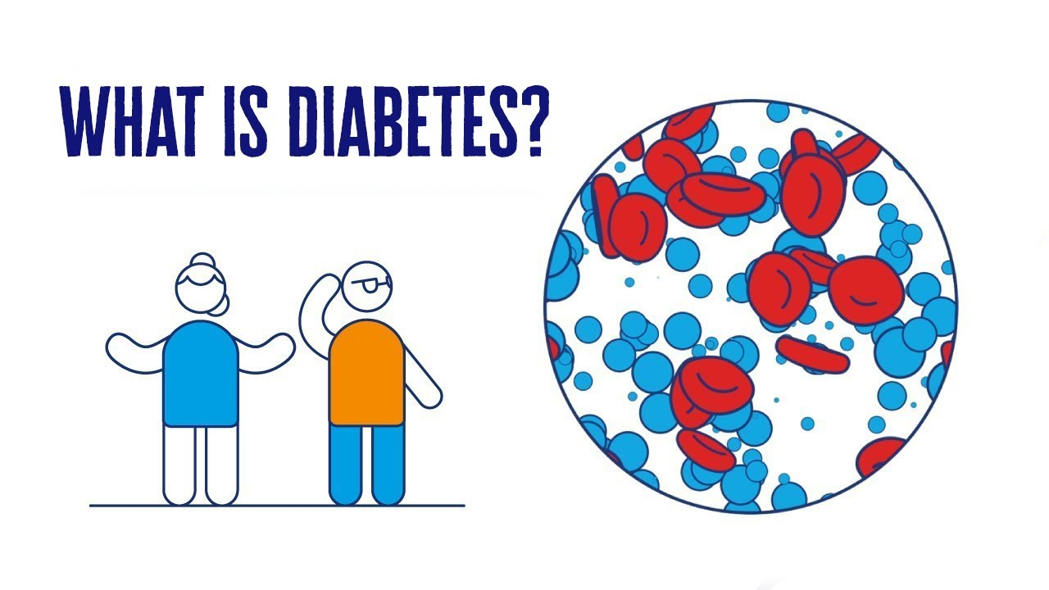
What is diabetes :
Diabetes, also known as diabetes mellitus, is a group of metabolic disorders characterized by a high blood sugar level (hyperglycemia) over a prolonged period of time. Symptoms often include frequent urination, increased thirst and increased appetite. If left untreated, diabetes can cause many health complications. Acute complications can include diabetic ketoacidosis, hyperosmolar hyperglycemic state, or death. Serious long-term complications include cardiovascular disease, stroke, chronic kidney disease, foot ulcers, damage to the nerves, damage to the eyes, and cognitive impairment.

Slide 6
Why we get diabetes :
Diabetes is due to either the pancreas not producing enough insulin, or the cells of the body not responding properly to the insulin produced. Insulin is a hormone which is responsible for helping glucose from food get into cells to be used for energy. There are three main types of diabetes mellitus
Food Habits that causes Diabetes :
A diet high in fat, calories, and cholesterol increases your risk of diabetes. A poor diet can lead to obesity (another risk factor for diabetes) and other health problems. A healthy diet is high in fiber and low in fat, cholesterol, salt, and sugar. Also, remember to watch your portion size.

Slide 7
Precautions for Diabetes :
Make a commitment to managing your diabetes. ...
Don't smoke. ...
Keep your blood pressure and cholesterol under control. ...
Schedule regular physicals and eye exams. ...
Keep your vaccines up to date. ...
Take care of your teeth. ...
Pay attention to your feet. ...
Consider a daily aspirin.

Slide 8
DIABETES → 126 or more (mg/DL)
PRE –DIABETES → 100-125 (mg/DL)
NORMAL → 99 or less (mg/DL)
Insulin : A normal measurement of free insulin is less than 17 mcU/mL .
Blood pressure : About two-thirds of the adult with diabetes have blood pressure greater
than 130/80 mm Hg .
Cholesterol : → under 100 (mg/dL) is considered ideal .
→ 100-129 mg/dL is close to ideal.
→ 130-159 mg/dL is borderline elevated.
Glucose : above 240 mg/dL.
Alcohol : → <30 ml per day for women.
→ <60 ml per day for men.

Slide 9
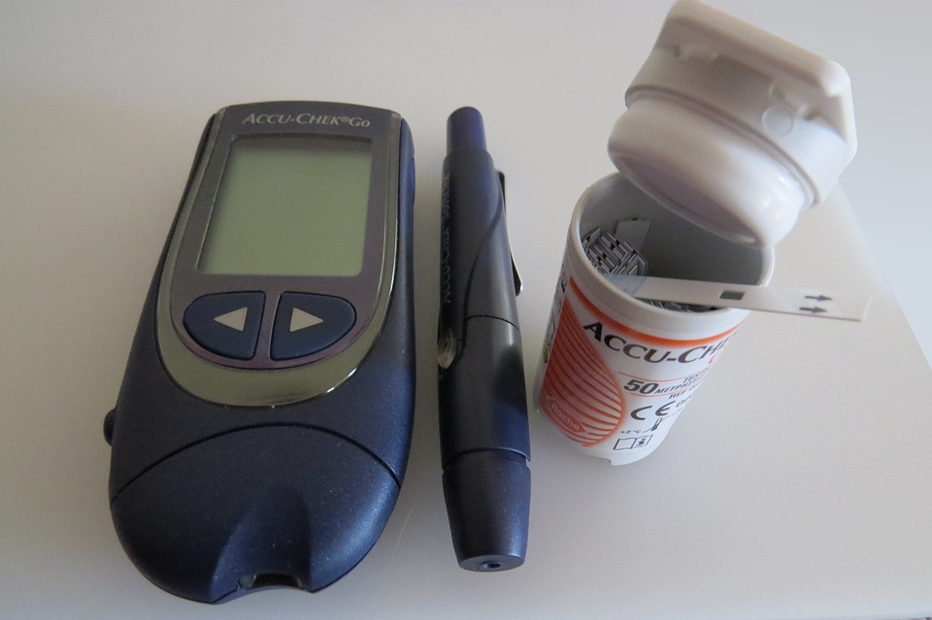
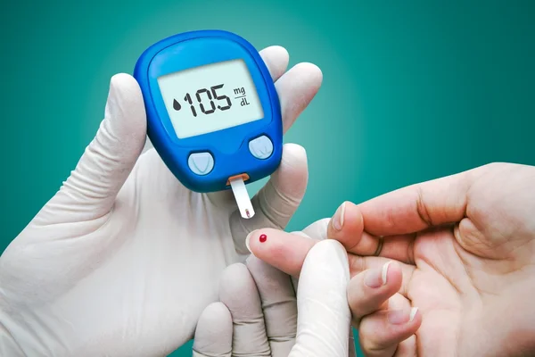
Smoking : 30% - 40% more likely to develop type 2 diabetes than people who don’t
smoke.
Testing of Sugar :
Blood Sugar testing requires the use Blood Sugar Meter .

Slide 10
DATA SET INFORMATION :
This dataset is created by Kaggle based on data taken from different people.
ATTRIBUTE INFORMATION:
Number of Instances: 768
Number of Attributes:24
Diabetes_012
HighBP:Diastolic blood pressure (mm Hg)
HighChol
CholCheck
BMI: Body mass index
Glucose: Plasma glucose concentration a 2 hours in an oral glucose tolerance test
Glucose: Plasma glucose concentration a 2 hours in an oral glucose tolerance test
SkinThickness: Triceps skin fold thickness (mm)

Slide 11
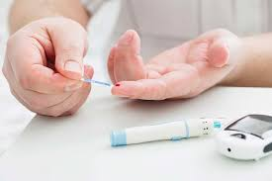
Glucose: Plasma glucose concentration a 2 hours in an oral glucose tolerance test
Insulin: 2-Hour serum insulin (mu U/ml)
Smoker
Stroke
HeartDiseaseorAttack
PhyActivity
Fruits
Veggies
HvyAlcoholConsump

Slide 12
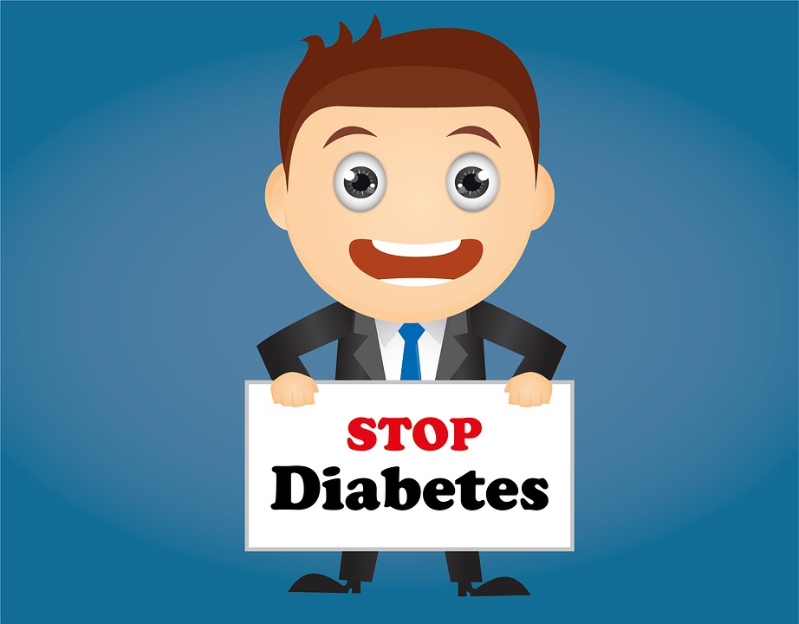
AnyHealthcare
NoDocbcCost
GenHlth
PhysHlth
DiffWalk
Sex: Categeory of person.
Age: Age (years)
Education
Income

Slide 13
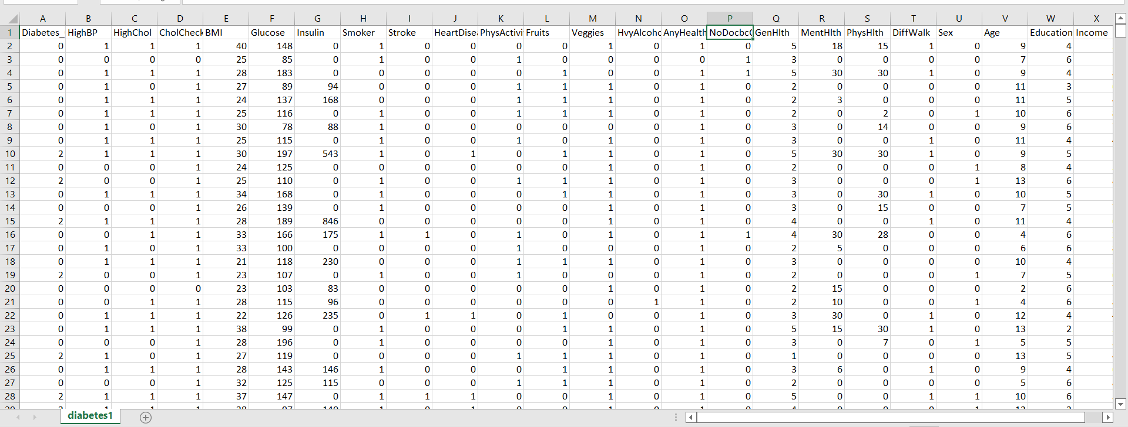

Slide 14
APPROACH :
In order to predict the diabetes among people we can use classification model to predict.
Number of Attributes:24

Slide 15
RESULT :
https://github.com/SIDDHU2016/reas/blob/main/code.ipynb

Slide 16
CONCLUSION:
By exploring the data set we know what are the factors which cause diabetes . So that we can aware of the disease .And it helps us what diet we should follow and what habits we should stop.

Slide 17
References :
https://www.ncbi.nlm.nih.gov/pmc/articles/PMC3123144/
https://en.m.wikipedia.org/wiki/Diabetes_management
https://www.studocu.com/in/document/bharathiar-university/bachelor-of-computer-application/diabetes-prediction-final-report/30159558

Slide 18
THANK YOU

